Slide 1

Department of Computer Science and Engineering
Next-Gen Attendance System
PRESENTED BY
B.Indu 21471A05E5
T.Tejaswini 21471A05L0
K.Abhinaya 21471A05G9
Under the Guidance of,
DR.S.V.N Sreenivasu M.Tech ph.D,
Department of Computer Science and Engineering,
Narasaraopeta Engineering College (Autonomous),
Narasaraopet- 522 601.

Slide 2
OUTLINE
Abstract
Introduction
Literature Survey
Research Gaps
Problem Statement
Objectives
Block Diagram / Flow Diagram
Methodology
Implementation
Results and Analysis
Conclusion & Future Scope
References
Question and Answers
Acknowledgements

Slide 3
ABSTRACT
The Next-Gen Attendance System is an advanced, automated solution designed to streamline real-time attendance tracking in educational environments using deep learning models. By employing YOLOv8 for precise face detection, it supports three modes of attendance capture: webcam live feeds, pre-recorded videos, and static images. Each detected face is uniquely labeled, ensuring no duplication across different sections. The system integrates Convolutional Neural Networks (CNN) to enhance facial feature recognition, ensuring accuracy even in dynamic conditions. This solution reduces manual effort and errors in attendance monitoring, with all records securely stored in easily accessible Excel sheets. It is tailored for modern classrooms and paves the way for AI-driven attendance management.

Slide 4
INTRODUCTION
1. Brief Introduction to the Project
The Next-Gen Attendance System is an automated, AI-driven solution that leverages deep learning models to streamline attendance tracking in educational settings. By utilizing advanced facial detection and recognition technologies such as YOLOv8 and CNN, the system accurately identifies students in real time, whether through live feeds, recorded videos, or static images. This innovative approach eliminates the need for manual attendance processes, enhancing the efficiency and accuracy of attendance management in modern classrooms.
2. Motivation behind the Project
The primary motivation behind the development of this system is to address the inefficiencies and inaccuracies associated with traditional attendance methods. Manual roll calls and paper-based systems are prone to human error, time-consuming, and susceptible to proxy attendance. With the increasing

Slide 5
demand for digital solutions in educational environments, there is a growing need for automated systems that can ensure accurate attendance records while minimizing administrative workload. The integration of AI into the attendance process provides a solution that is both time-efficient and scalable.
3. Importance and Relevance
The importance of this project lies in its potential to revolutionize attendance tracking by reducing the manual labor involved in monitoring student presence. In an era where educational institutions are embracing digital transformation, this system offers a relevant and forward-thinking solution that enhances data accuracy, reduces errors, and provides valuable insights through real-time tracking. The system’s adaptability across different classroom settings makes it a valuable tool for educational administrators seeking to improve operational efficiency and ensure compliance with attendance policies.

Slide 6
LITERATURE SURVEY
No | Title | Author | Journal Name & Year | Methodology Adapted | Key Findings | Gaps
1 | A Classroom Usage Monitoring System with Image Detection for Student Attendance | D. B. Hidayat, B. M. Nugraha, D. A. D. Bagaskara, D. P. Widyadhana, D. Purwitasari, I. K. E. Purnama | ICoSEIT, 2024 https://ieeexplore.ieee.org/document/10497524 | Image detection for monitoring classroom usage and student attendance | Improved student attendance tracking and efficient classroom usage monitoring | Limited to specific classroom environments; does not address outdoor attendance scenarios.
2 | Student Recognition and Activity Monitoring in E-Classes Using Deep Learning in Higher Education | N. M. Alruwais, M. Zakariah | IEEE Access, 2024 https://www.researchgate.net/publication/377478273_Student_Recognition_and_Activity_Monitoring_in_E-Classes_Using_Deep_Learning_in_Higher_Education | Deep learning-based recognition for e-class monitoring | Enhanced student engagement and automated activity monitoring | May struggle with variations in lighting and student occlusions

Slide 7
LITERATURE SURVEY
No | Title | Author | Journal Name & Year | Methodology Adapted | Key Findings | Gaps
3 | Face Recognition Smart Attendance System using Deep Transfer Learning | K. Alhanaee, M. Alhammadi, N. Almenhali, M. Shatnawi | Procedia Comput. Sci., 2021 https://www.sciencedirect.com/science/article/pii/S1877050921019232 | Deep transfer learning for smart attendance | High accuracy in face recognition-based attendance systems | Requires a high-quality dataset and faces challenges with occlusions
4 | Smart Attendance System Using CNN | S. Arya, H. Mesariya, V. Parekh | Pandit Deendayal Petroleum University, 2023 https://arxiv.org/pdf/2004.14289 | Convolutional Neural Networks (CNN) for attendance tracking | Reliable attendance system using CNN for facial recognition | No integration with other authentication methods like RFID or biometrics

Slide 8
LITERATURE SURVEY
No | Title | Author | Journal Name & Year | Methodology Adapted | Key Findings | Gaps
5 | Smart Attendance Management System Using Geo-Fencing and Machine Learning | P. S. V. Lakshmi, R. Kumaraswamy, A. Manhar | IJCRT, 2023 https://www.ijcrt.org/papers/IJCRT2306541.pdf | Geo-fencing and ML-based attendance tracking | Location-based attendance tracking ensures authenticity | Dependent on mobile GPS accuracy; may not work well in enclosed spaces

Slide 9
RESEARCH GAPS
1. A Classroom Usage Monitoring System with Image Detection for Student Attendance (IEEE Paper)
Their Model: Uses image detection to monitor classroom usage and student attendance.
Difference: Their model focuses on tracking classroom occupancy and attendance, whereas your system integrates multiple methods (live webcam, uploaded videos/photos) to ensure more flexible and accurate attendance tracking.
2. Student Recognition and Activity Monitoring in E-Classes Using Deep Learning in Higher Education (IEEE Access Paper)
Their Model: Focuses on student recognition and monitoring in virtual classrooms.
Difference: Their model is designed for online learning environments, while your system is built for physical classrooms, utilizing webcams, uploaded videos, and images for attendance tracking, making it more versatile for in-person learning.

Slide 10
RESEARCH GAPS
3. Face Recognition Smart Attendance System using Deep Transfer Learning (Procedia Computer Science Paper)
Their Model: Uses deep transfer learning for face recognition in smart attendance systems.
Difference: Their model is mainly focused on transfer learning techniques, whereas your project uses YOLOv8 and CNN-based facial recognition, which ensures faster and more precise detection in real-time classroom environments.
4. Smart Attendance System Using CNN (IJCRT Paper)
Their Model: Uses Convolutional Neural Networks (CNN) for facial recognition-based attendance tracking.
Difference: Their system is limited to CNNs, while your project combines CNNs with YOLOv8 for enhanced real-time detection and tracking, ensuring better accuracy in diverse classroom conditions.

Slide 11
RESEARCH GAPS
5. Smart Attendance Management System Using Geo-Fencing and Machine Learning (IJCRT Paper)
Their Model: Uses geo-fencing and machine learning to track student attendance based on location.
Difference: Their system relies on GPS-based location tracking, which may not work effectively indoors. Your system eliminates the need for location tracking and instead focuses on facial recognition, making it more adaptable to various classroom settings.

Slide 12
PROBLEM STATEMENT
In traditional classrooms, taking attendance manually is time-consuming, prone to errors, and easily manipulated by students through proxy attendance. Current automated systems often lack real-time capabilities, flexibility in input methods (webcam, video, image), or focus solely on virtual classrooms, limiting their use in dynamic, physical classroom environments.
There is a need for a real-time, automated attendance system that is accurate, fast, and adaptable to various educational settings, while ensuring secure storage of attendance records and reducing manual effort.

Slide 13
OBJECTIVES
Automate Attendance:
Make attendance automatic with face recognition to save time and effort.
Improve Accuracy:
Use advanced AI models to ensure attendance is marked accurately and quickly.
Flexible Options:
Allow teachers to choose from webcam, video, or images to mark attendance.
Secure Data:
Store attendance records safely in Excel with the time and student details.
Prevent Proxy Attendance:
Stop students from faking attendance with reliable face recognition.
Scalable System:
Build a system that can easily be used in different schools and classrooms.
Real-Time Monitoring:
Help teachers track students' attendance in real-time during class.

Slide 14
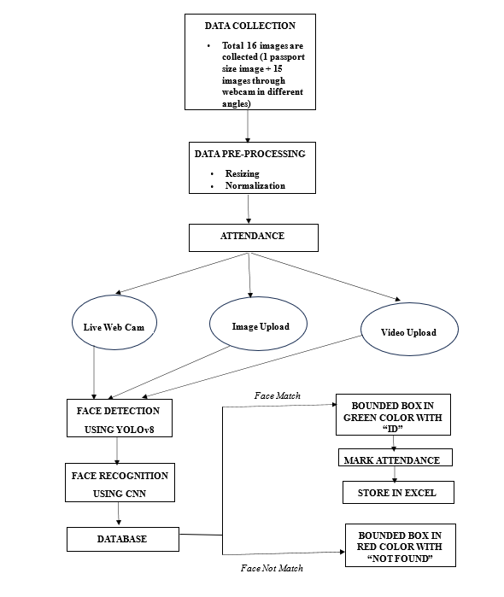
BLOCK DIAGRAM AND FLOW CHART
AUTOMATED STUDENT ATTENDENCE SYSTEM
flowchart depicting the attendance process with steps
like data collection, face detection
KEY STEPS:
Data collection
Face detection
Face recognition
Attendance marking
BENEFITS:
Saves time and reduce effort.
High accuracy with deep learning.

Slide 15
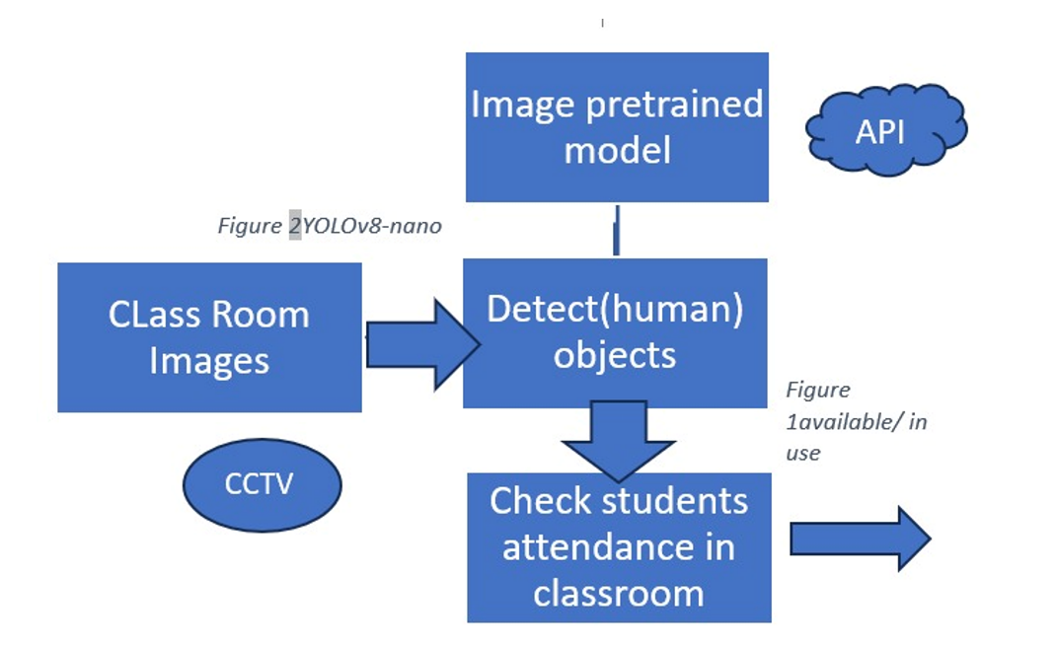
BLOCK DIAGRAM AND FLOW CHART
Yolo v8-nono-based student attendance
System:
1.Key features:
Efficient object detection
Support 4k cameras
Reliable in challenging environments
Scalable solution
2.Applications:
Educational institutions
Corporate training and workshops
Large lecture halls and seminar events.

Slide 16
METHODOLOGY
Preprocessing
Objective: To prepare the input data (images, videos) for the face detection model.
Steps:
Resizing Images: The input images are resized to fit the input size required by the YOLOv8 model.
Normalization: Image pixel values are normalized to speed up the processing and improve the accuracy of detection.

Slide 17






METHODOLOGY
Preprocessing
Before Preprocessing After Preprocessing

Slide 18
METHODOLOGY
Frameworks and Algorithms
Framework Used:
PyTorch: The deep learning framework used to implement the YOLOv8 model.
OpenCV: For handling video streams and capturing live images from the webcam.
Excel: Used for storing and managing attendance data in tabular form.

Slide 19
METHODOLOGY
Algorithms:
YOLOv8 (You Only Look Once):
Task: Real-time object (face) detection in images and videos.
Parameters:
Input size: Adjusted to match the resolution of classroom videos.
Confidence Threshold: Set to a threshold (e.g., 0.5) to ensure only accurate detections are considered for attendance.
Non-Maximum Suppression (NMS): Applied to avoid multiple detections of the same face.
CNN (Convolutional Neural Networks):
Task: Feature extraction from detected faces to confirm identity.

Slide 20
METHODOLOGY
4.Tools Used
YOLOv8: For real-time object (face) detection.
OpenCV: For capturing and processing live webcam input and handling pre-recorded video.
Excel: For saving attendance records (including timestamps) in an organized format.
PyTorch: The primary framework used for model development and deployment.

Slide 21
METHODOLOGY
5.Parameter Settings (in Table Form)
Parameter | Value | Purpose
YOLOv8 Input Size | 640x640 | Resolution for input images/videos
Confidence Threshold | 0.5 | Threshold for face detection accuracy
NMS (Non-Max Suppression) | 0.4 | To prevent multiple detections of one face
Batch Size | 16 | Number of images processed per batch
Learning Rate | 0.001 | Speed of learning during model training

Slide 22
IMPLEMENTATION
Software Implementation:
Development Environment
Programming Language: Python
Libraries Used:
OpenCV: For image processing tasks such as reading images, video capture, and handling webcam inputs.
YOLOv8: Utilized for real-time face detection with high precision and speed.
Excel: For efficient storage and manipulation of attendance records in Excel files, including timestamp-based tracking.
Frameworks:
PyTorch: For implementing convolutional neural networks (CNNs) that extract and recognize facial features.

Slide 23
IMPLEMENTATION
Hardware Implementation
1. Required Hardware:
Webcam:
Minimum: 720p HD (2-5 feet detection).
Recommended: 4K Ultra HD (10-15 feet detection).
System Requirements:
Minimum: Intel i5, 8GB RAM.
Recommended: Intel i7/i9, 16GB+ RAM, dedicated GPU.
2. Hardware Integration:
High-resolution cameras integrated with YOLOv8 for real-time detection.
Local system setup for live image/video capture and processing.

Slide 24
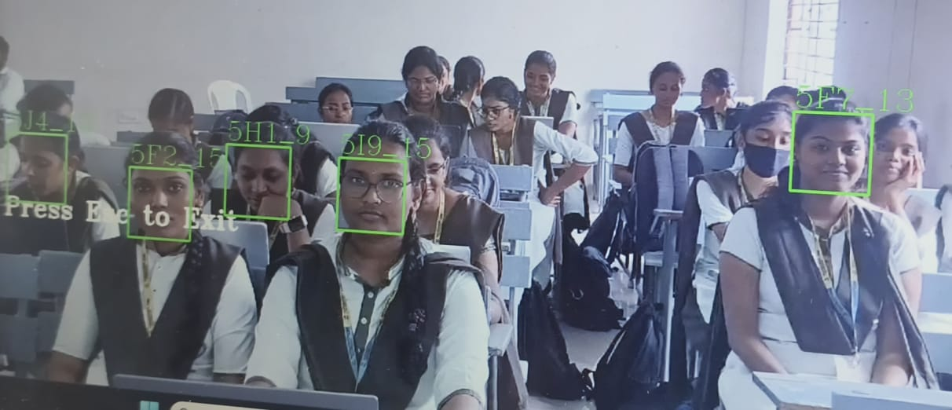
IMPLEMENTATION
Challenges and Solutions in Implementation
Overcrowding and Occlusion
Challenge: Difficulty detecting faces in crowded areas.
Solution: Use YOLOv8 for accurate detection with
high-resolution cameras.
Lighting Variability
Challenge: Reduced detection in low-light conditions.
Solution: Apply contrast enhancement for better reliability.
Duplicate Attendance
Challenge: Risk of multiple entries for the same person.
Solution: Use timestamp-based cross-checks to avoid duplication.
Dynamic Updates
Challenge: Adding new individuals without disrupting the system.
Solution: Enable real-time encoding and seamless updates.

Slide 25
IMPLEMENTATION
Implementation Workflow
Input Methods:
Webcam, static images, videos
Processing Steps:
Face Detection: YOLOv8 detects faces.
Face Encoding: CNN generates encodings.
Matching: Compare with stored database entries.
Output:
Attendance stored in Excel with names, timestamps, and sections.

Slide 26
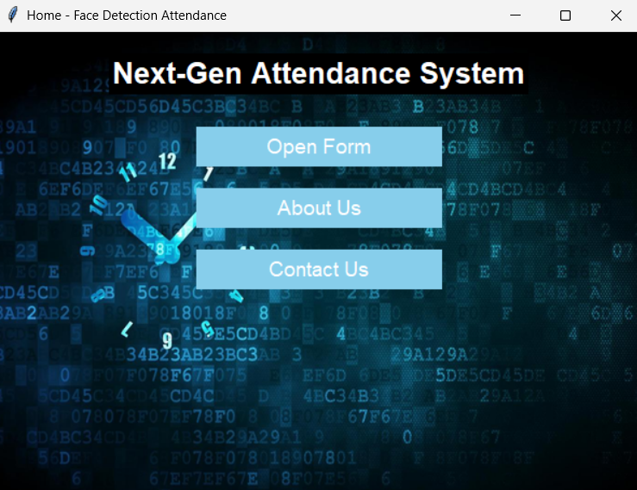
RESULTS & ANALYSIS
An advanced AI-driven attendance management system designed to enhance accuracy, efficiency, and security in educational institutions.
Navigation Options:
Open Form: Access the student registration form to add new records.
About Us: Learn more about the system and its developers.
Contact Us: Get in touch for support and queries.

Slide 27
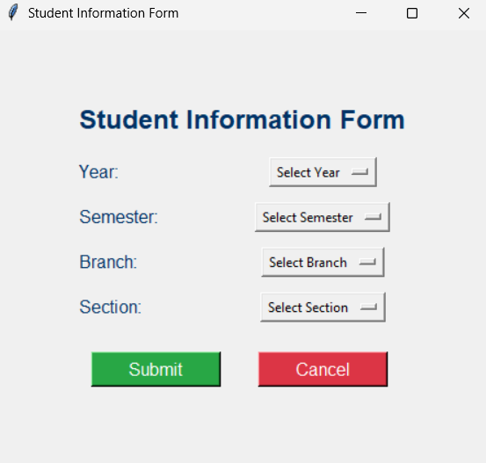
RESULTS & ANALYSIS
Efficient Student Data Collection
Before marking attendance, students' details need to be recorded to ensure proper classification and tracking.
Key Features:
Year Selection: Choose the academic year.
Semester Selection: Specify the current semester.
Branch Selection: Select the department.
Section Selection: Assign the student to the correct section.

Slide 28
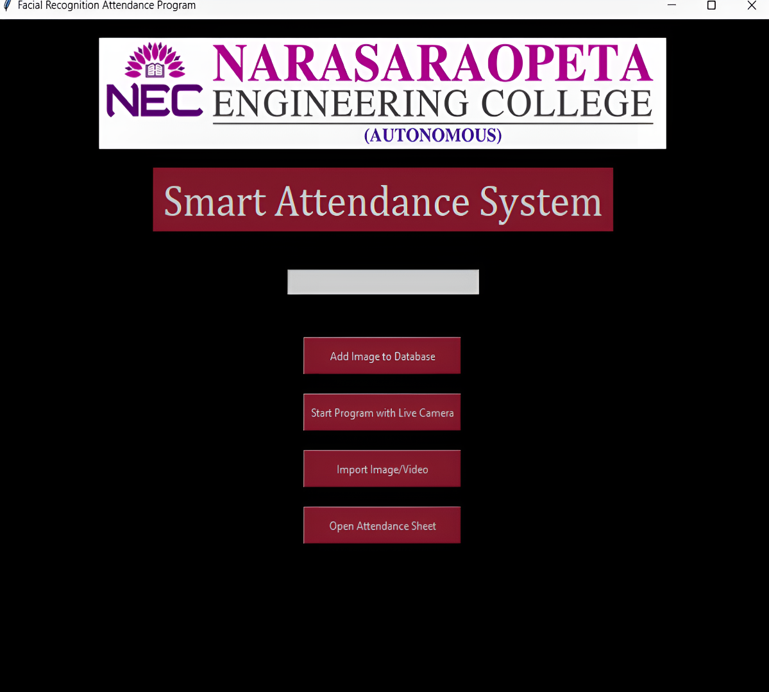
RESULTS & ANALYSIS
System Features & Attendance Modes
Attendance Marking Options: Teachers can select from three modes for marking attendance:
Live Webcam: Real-time face detection using a webcam.
Pre-recorded Video: Processes video footage to detect and label faces.
Static Image: Uses images for attendance tracking.

Slide 29
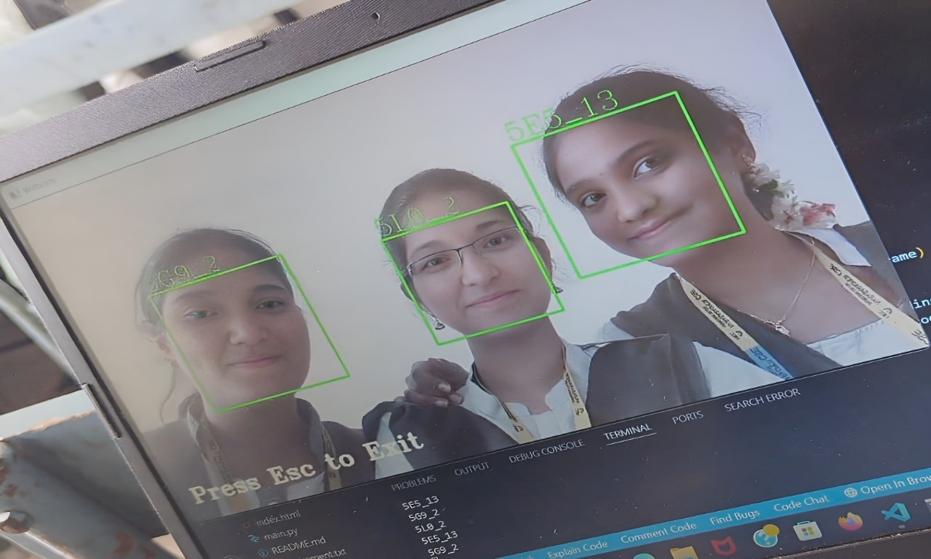
RESULTS & ANALYSIS
Face Detection Capabilities:Real-time
Detection:
Identifies faces via webcam, marking them with green bounding boxes and unique IDs.
Video-based Detection:
Detects and labels faces from pre-recorded videos in a classroom setting.

Slide 30
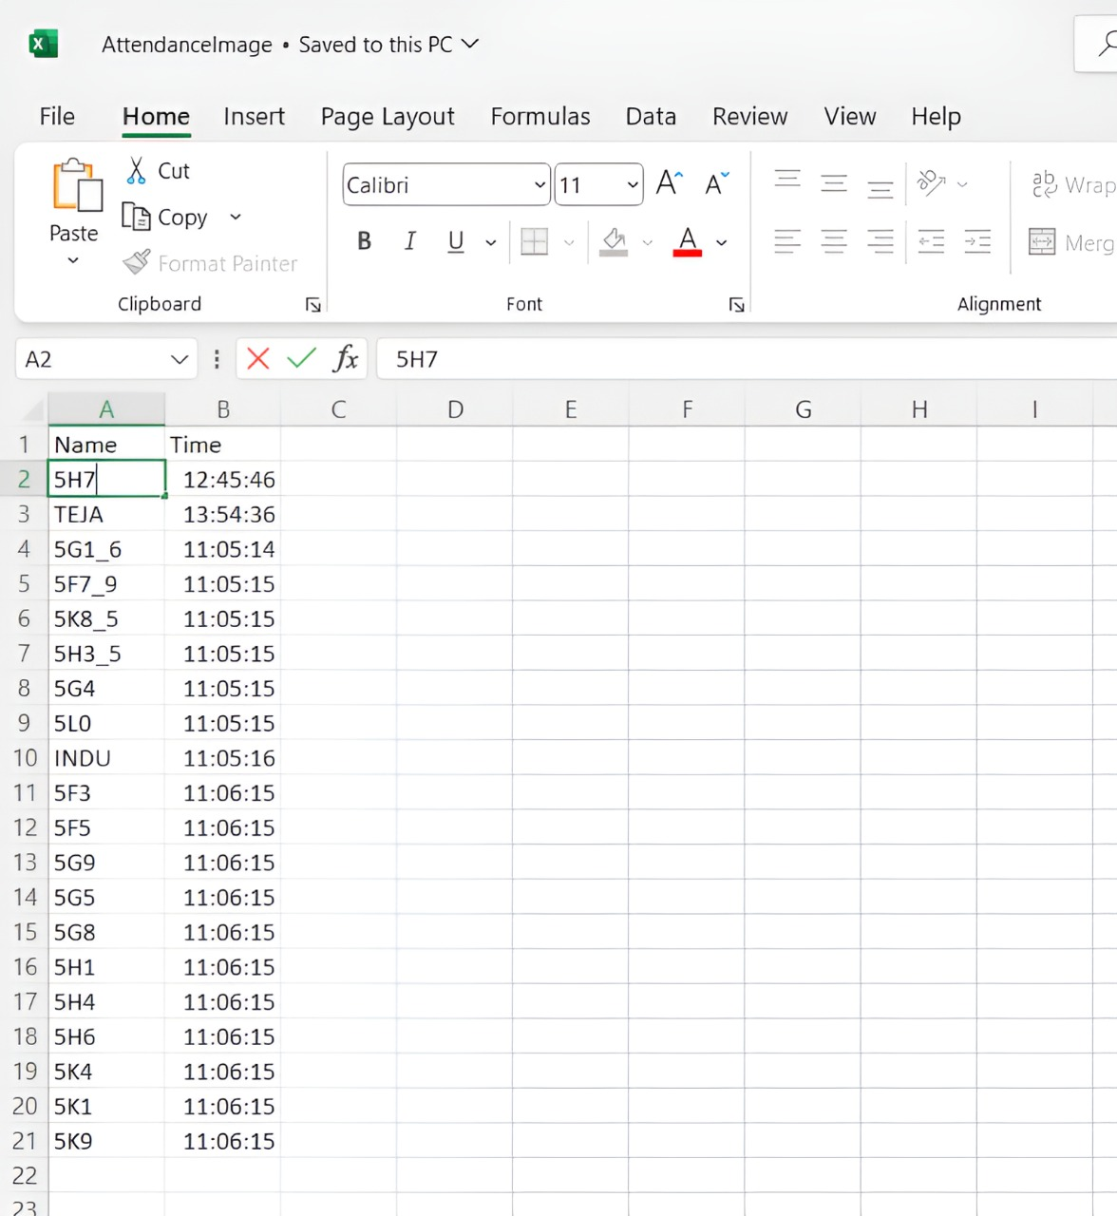
RESULTS & ANALYSIS
Data Management & Attendance Records
Student Information Form: Interface for collecting and managing student data, ensuring accurate tracking and database management.
Attendance Storage:Attendance records (roll number, timestamp) are automatically stored in Excel, ensuring accurate, efficient, and secure tracking.
Flexibility for Teachers:
Teachers can choose the most suitable attendance mode, making the system adaptable to their needs.

Slide 31
CONCLUSION and FUTURE SCOPE
The Next-Gen Attendance System is an innovative solution that greatly enhances classroom attendance management through the use of AI technologies. It ensures accurate, real-time attendance tracking, making the process more efficient and reliable.
It is scalable, accurate, and efficient. Future improvements may include enhanced security features (e.g., anti-spoofing), greater scalability for large institutions, and integration with broader data management systems.

Slide 32
REFERENCES
Widyadhana, D. Purwitasari, and I. K. E. Purnama, “A Classroom Usage Monitoring System with Image Detection for Student Attendance,” in 2024 2nd Int. Conf. Softw. Eng. Inf. Technol. (ICoSEIT), Bandung, Indonesia, 2024, pp. 7–12, doi: 10.1109/ICoSEIT60086.2024.10497524.
N. M. Alruwais and M. Zakariah, “Student Recognition and Activity Monitoring in E-Classes Using Deep Learning in Higher Education,” IEEE Access, vol. 12, pp. 66110–66125, 2024, doi: 10.1109/ACCESS.2024.3354981.
P. S. V. Lakshmi, R. Kumaraswamy, and A. Manhar, “Smart Attendance Management System Using Geo-Fencing and Machine Learning,” Int. J. Creat. Res. Thoughts (IJCRT), vol. 11, no. 6, pp. e766–e772, 2023.
K. Alhanaee, M. Alhammadi, N. Almenhali, and M. Shatnawi, “Face Recognition Smart Attendance System using Deep Transfer Learning,” Procedia Comput. Sci., vol. 192, pp. 4093–4102, 2021, doi: 10.1016/j.procs.2021.09.184.
Md. Y. Ali, X. Zhang, and H. Rashid, “Student Activities Detection of SUST using YOLOv3 on Deep Learning,” Indones. J. Electr. Eng. Inform., vol. 8, no. 4, Dec. 2020, doi: 10.11591/ijeei.v8i4.2585.

Slide 33
REFERENCES
S. Arya, H. Mesariya, and V. Parekh, “Smart Attendance System Using CNN,” Department of Computer Science, Pandit Deendayal Petroleum University, Gandhinagar, India, 2023.
Z. A. T. Ahmed, M. E. Jadhav, A. M. Al-madani, M. Tawfik, S. N. Alsubari, and A. A. A. Shareef, “Real-time Detection of Student Engagement: Deep Learning-based System,” in Proc. Int. Conf. Innov. Comput. Commun. (ICICC), vol. 1, pp. 313–323, 2022.
S. Leelavathy, R. Jaichandran, K. S. Shalini, B. Surendar, A. K. Philip, and D. R. Raja, “Students’ Attention and Engagement Prediction using MachineLearning Techniques,” Eur. J. Mol. Clin. Med., vol. 7, no. 4, pp. 3011–3017, 2020.
M. U. Uc¸ar and E. Ozdemir, “Recognizing Students and Detecting Student ¨ Engagement with Real-time Image Processing,” Electronics, vol. 11, no. 9, p. 1500, May 2022.
Z. Trabelsi, F. Alnajjar, M. M. A. Parambil, M. Gochoo, and L. Ali, “Real-time Attention Monitoring System for Classroom: A Deep Learning Approach for Student’s Behavior Recognition,” Big Data Cognit. Comput., vol. 7, no. 1, p. 48, Mar. 2023.

Slide 34
REFERENCES
Z. Trabelsi, F. Alnajjar, M. M. A. Parambil, M. Gochoo, and L. Ali, “Real-time Attention Monitoring System for Classroom: A Deep Learning Approach for Student’s Behavior Recognition,” Big Data Cognit. Comput., vol. 7, no. 1, p. 48, Mar. 2023.
I. Lasri, A. R. Solh, and M. E. Belkacemi, “Facial Emotion Recognition of Students using Convolutional Neural Network,” in Proc. 3rd Int. Conf. Intell. Comput. Data Sci. (ICDS), Oct. 2019, pp. 1–6.
M. Karunakar, C. A. Sai, K. Chandra, and K. A. Kumar, “Smart Attendance Monitoring System (SAMS): A Face Recognition Based Attendance System for Classroom Environment,” Int. J. Recent Dev. Sci. Technol., vol. 4, no. 5, pp. 194–201, 2020.
F. P. Filippidou and G. A. Papakostas, “Single Sample Face Recognition Using Convolutional Neural Networks for Automated Attendance Systems,” in 2020 Fourth Int. Conf. Intell. Comput. Data Sci. (ICDS), 2020.
N. Soni, M. Kumar, and G. Mathur, “Face Recognition using SOM Neural Network with Different Facial Feature Extraction Techniques,” Int. J. Comput. Appl., vol. 76, no. 3, pp. 7–11, 2013.
S. Matilda and K. Shahin, “Student Attendance Monitoring System
Using Image Processing,” in 2019 IEEE Int. Conf. Syst., Comput., Autom. Netw. (ICSCAN), Pondicherry, India, 2019, pp. 1–4, doi: 10.1109/ICSCAN.2019.8878806.

Slide 35
QUESTIONS and ANSWERS
Please ask questions if there are any doubts

Slide 36
THANK YOU

